Slide 1
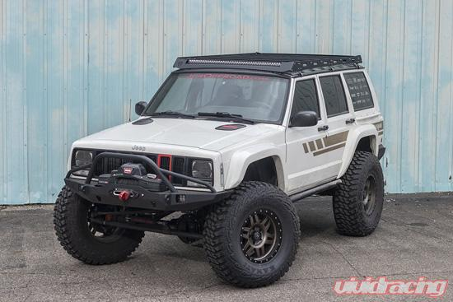
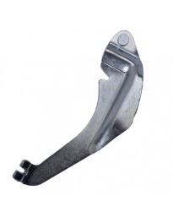
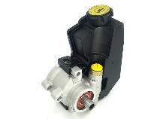
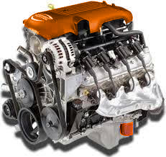
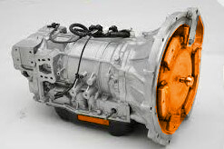
Jeep Cherokee XJ
Torque:
225 ft-lbs
Wheels
2nd Class Lever:
Brake Pedal
Rack and Pinion
Hoses
Power Steering Pump: 2.6 GPM
Description of system:
The Jeep Cherokee XJ is a "sport utility vehicle" with many mechanical, electrical, computer controlled systems. The XJ is designed for general transportation of people and cargo as well as adventures of off-roading and overlanding.
Mechanical Systems:
Gear Ratio: 3.55:1
190 HP
Control Systems:
Electrical Systems:
Fuel Injector Anti-lock Brakes Cruise Control
Battery Alternator Starter | Ignition Lighting Auxiliary
Gauge Cluster
A Mechatronic System

